Slide 1
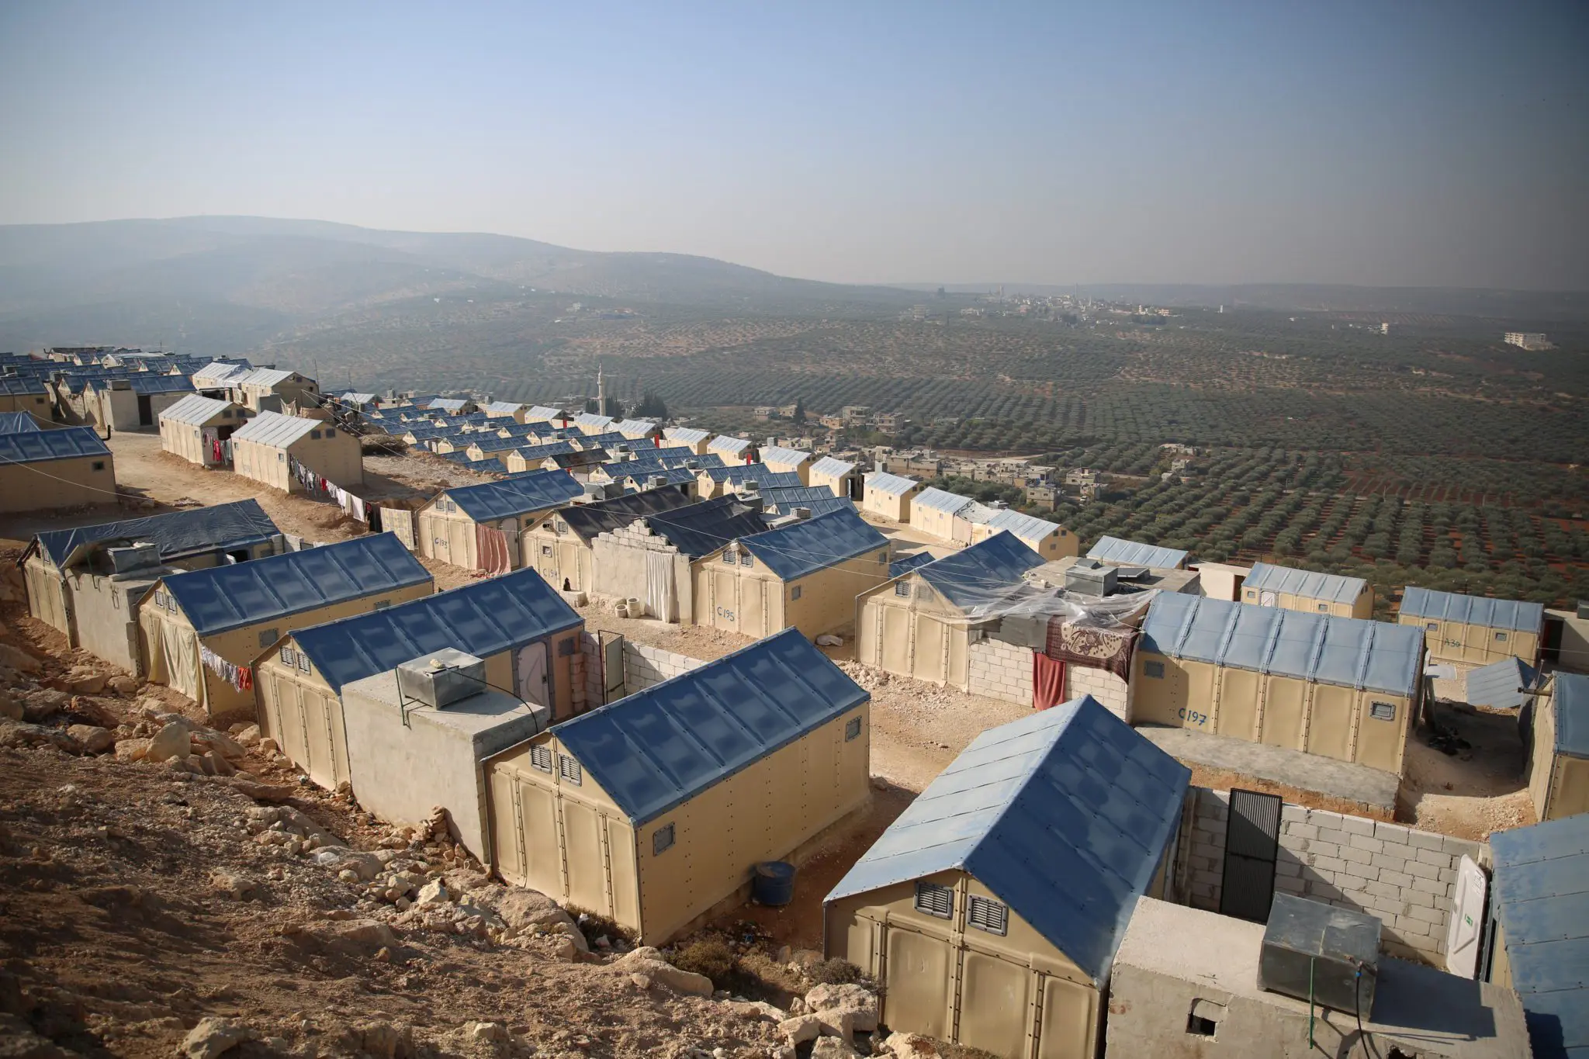
DESN3002 Proposal
La’O, Bernadette 3035957329

Slide 2
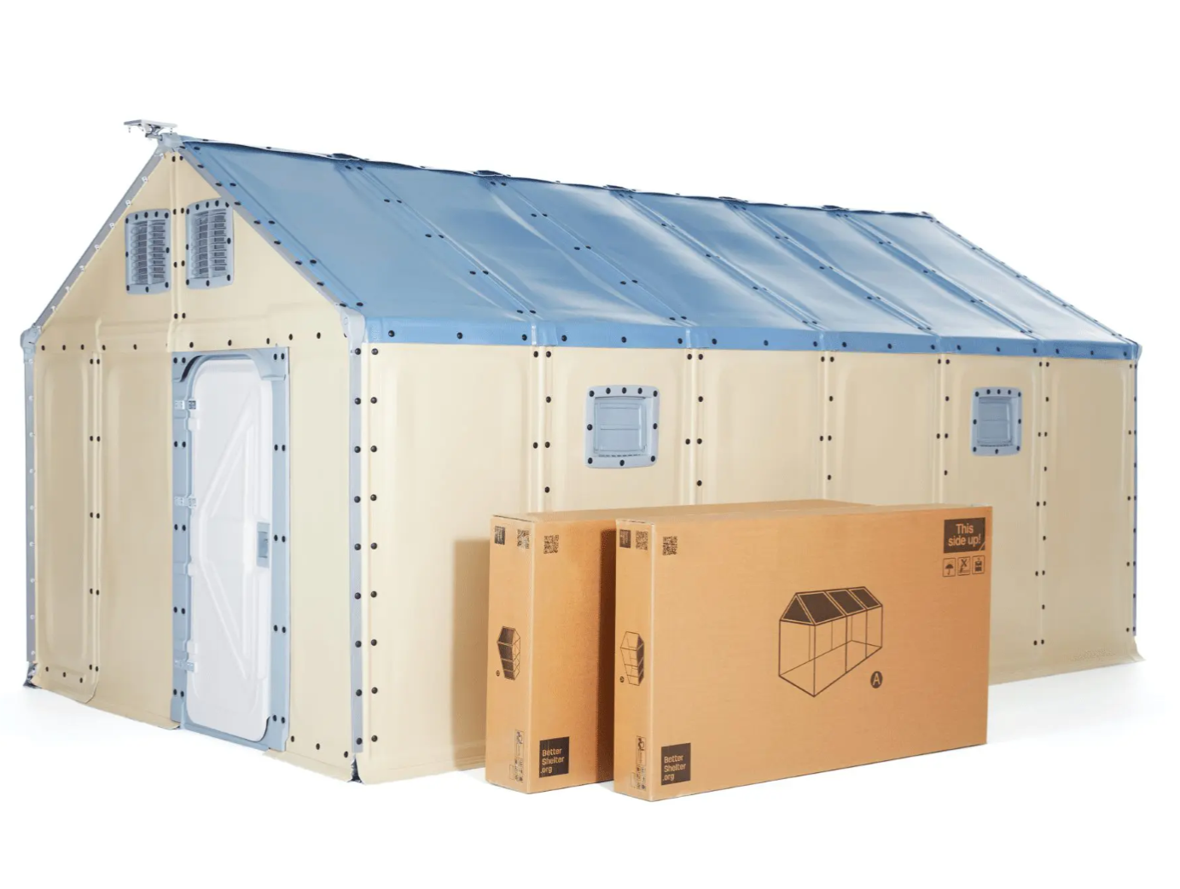


Better Shelter
Relief Housing Unit
Notes:
Already has two design iterations with these improvements
Increased accessibility, non-flammability, local employment and material use, ventilation

Slide 3
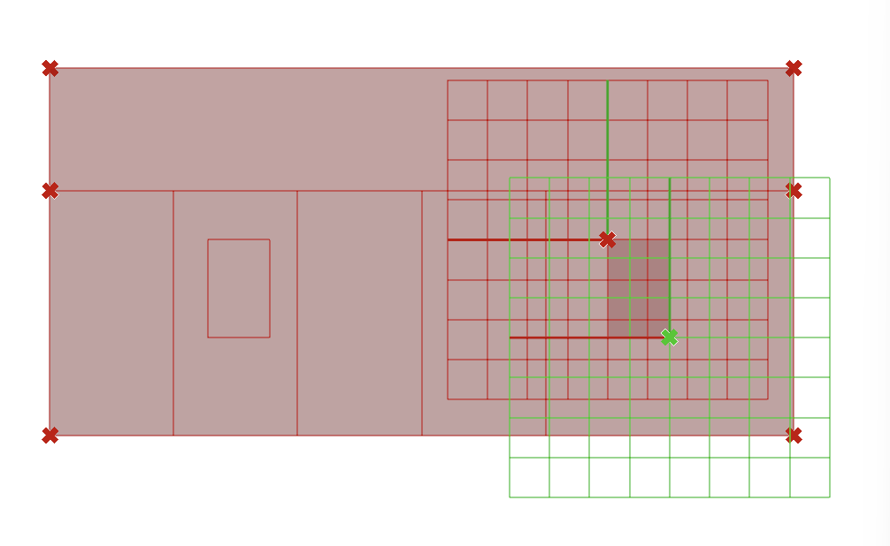
Process
Arbitrary, unspecific, relative, inconsistent metrics, buggy, bad isolation of variables
Failed to observe relationships between variables
Made hard assumptions and conclusions off of preliminary findings
Distance
Aspect ratio
Size
Number
Notes:
Size (x1) and aspect ratio (x2) can be controlled by the x y coordinates of a single point of a 2 pt. Rectangle (other point is anchored), size is made bigger or smaller by moving diagonally, aspect ratio varies from horizontal to vertical
Distance (x3) and number (x4) are controlled under the array function
Had to simplify sliders involved because simulation takes 1 minute each combination
Just need to control two surfaces (pictured above is only one surface, the second surface is the front of the house with the higher windows), these are then projected to the opposite wall automatically
Ladybug + Honeybee = daylight analysis, Colibri optimization, Design Explorer to graph patterns

Slide 4
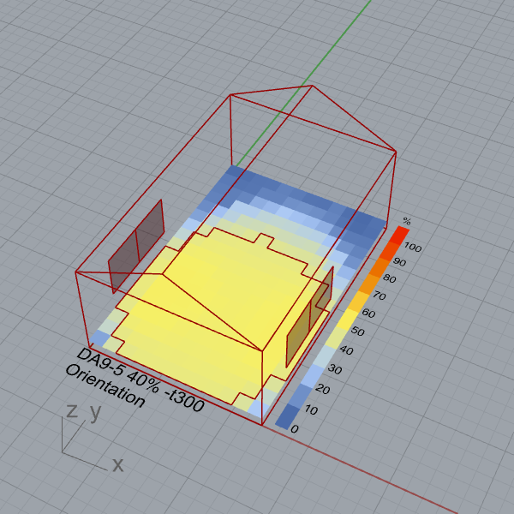
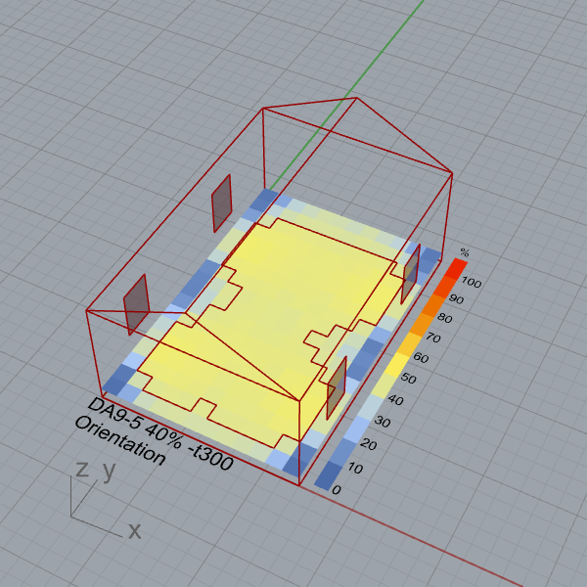
Distance vs Size
Distance can make up for size…
Two 3:3
59% DA
Two 2:3
60% DA
~=
Notes:
Fast and easy assembly (4 hours, 4 people, no tools)
Optimized production (4 flat packed boxes, relatively low cost and weight)
Long term alternative (lasts 3 years, more secure and durable than tents)
Multipurpose expandability (steel structure can be combined to become bigger for schools and infirmaries)

Slide 5
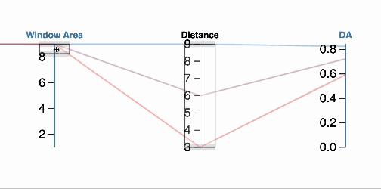
Distance vs Size
…but according to their proportional relationship
Notes:
Fast and easy assembly (4 hours, 4 people, no tools)
Optimized production (4 flat packed boxes, relatively low cost and weight)
Long term alternative (lasts 3 years, more secure and durable than tents)
Multipurpose expandability (steel structure can be combined to become bigger for schools and infirmaries)

Slide 6
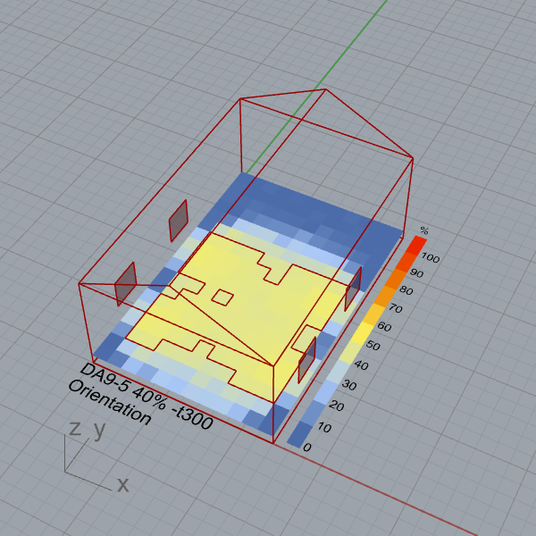
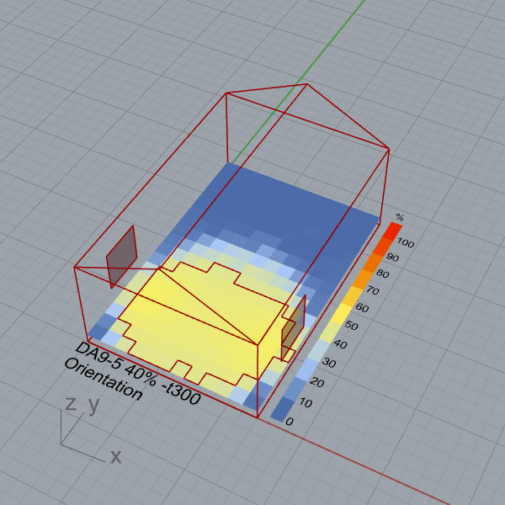
Number vs Size
Number can make up for size…
Two 2:2
Closer
39% DA
One 3:3
34% DA
>
Notes:
Fast and easy assembly (4 hours, 4 people, no tools)
Optimized production (4 flat packed boxes, relatively low cost and weight)
Long term alternative (lasts 3 years, more secure and durable than tents)
Multipurpose expandability (steel structure can be combined to become bigger for schools and infirmaries)

Slide 7
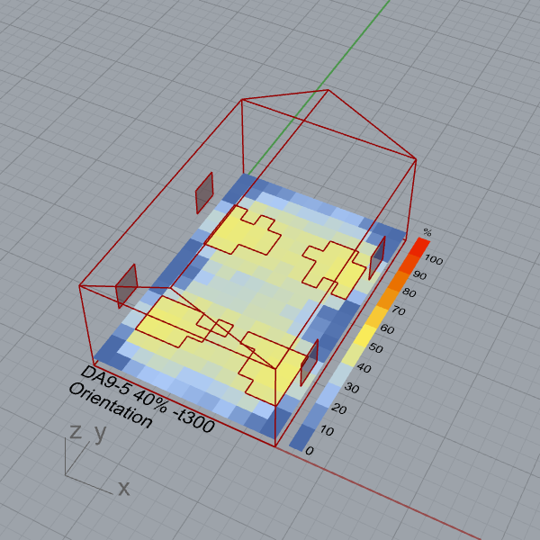
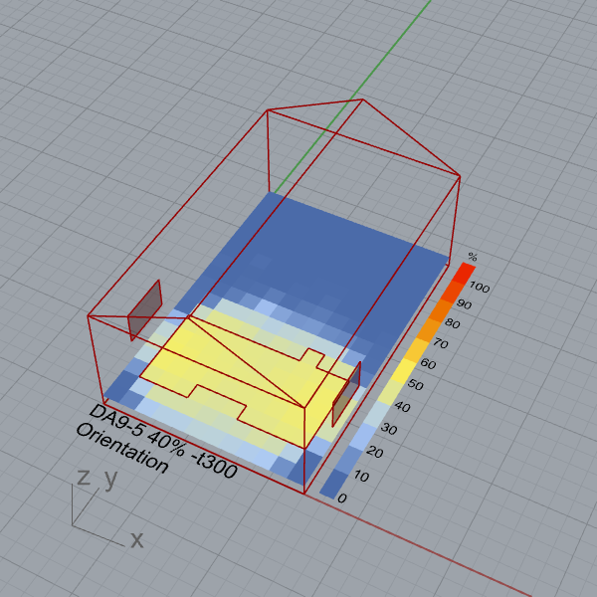
Number vs Size
…but performance heavily relies on distance as well
Two 2:2
Farther
21% DA
One 3:2
22% DA
~=
Notes:
Fast and easy assembly (4 hours, 4 people, no tools)
Optimized production (4 flat packed boxes, relatively low cost and weight)
Long term alternative (lasts 3 years, more secure and durable than tents)
Multipurpose expandability (steel structure can be combined to become bigger for schools and infirmaries)

Slide 8
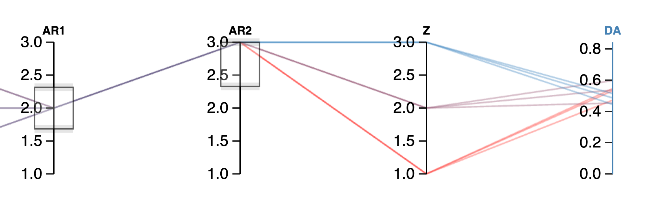
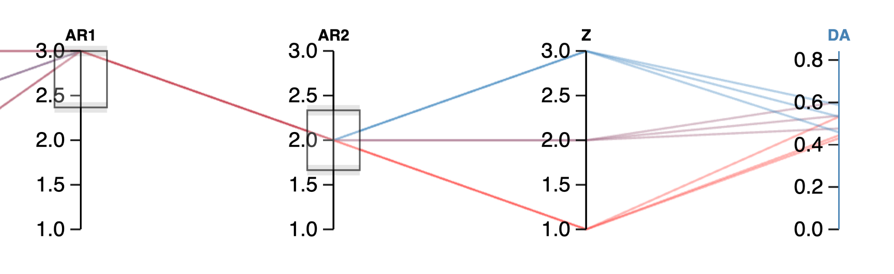
Aspect Ratio vs Height
Minimal effect on their own and to each other
Vertical
Horizontal
Notes:
Fast and easy assembly (4 hours, 4 people, no tools)
Optimized production (4 flat packed boxes, relatively low cost and weight)
Long term alternative (lasts 3 years, more secure and durable than tents)
Multipurpose expandability (steel structure can be combined to become bigger for schools and infirmaries)

Slide 9
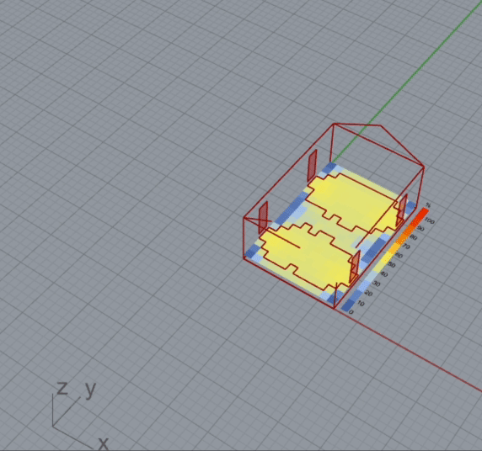
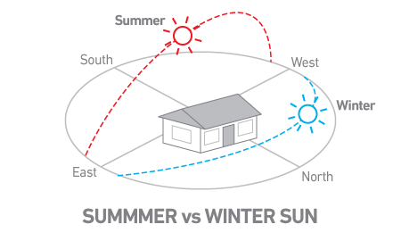
N
Orientation
East-west windows receive direct sunlight more consistently
Notes:
Fast and easy assembly (4 hours, 4 people, no tools)
Optimized production (4 flat packed boxes, relatively low cost and weight)
Long term alternative (lasts 3 years, more secure and durable than tents)
Multipurpose expandability (steel structure can be combined to become bigger for schools and infirmaries)

Slide 10
Key Insights
Size and distance have a proportional relationship
Number and size has less intuitive interchangeability with volatile dependence on distance
Aspect ratio effect is not as important as size
Greatest annual daylight uses east-west windows
Limitations: 2D measurement disregards evenness, simulation time, small scale limits effects
Notes:
Vertical and lower windows have more direct sunlight while higher windows are better for even distribution
Finding distance ‘sweet spot’ depends on all variables and room size
Number and size could be interchangeable to make up for the lack of the other
Factors affect one another and should be isolated even further for next study
Next steps include more in-depth structural analysis (max displacement, min thickness) for more informed optimization of all variables together
Also can separate panels and project windows onto them individually rather than array function for more control
Can even explore heat/temperature and shade mechanisms

Slide 11
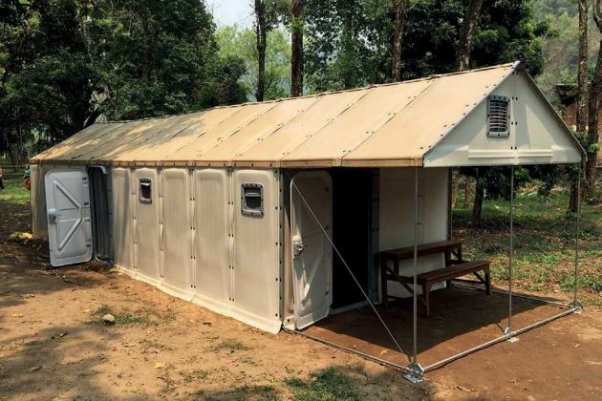
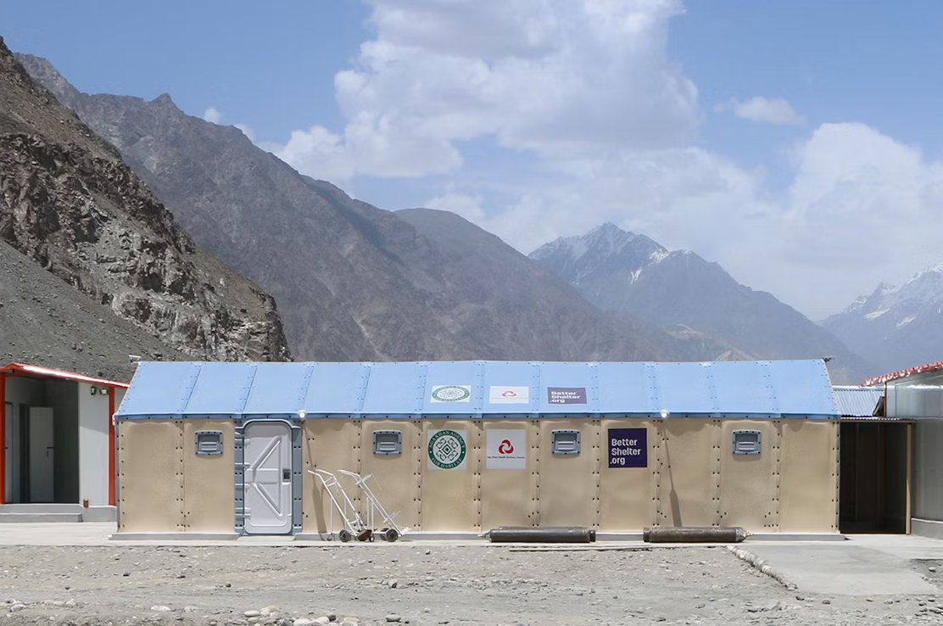
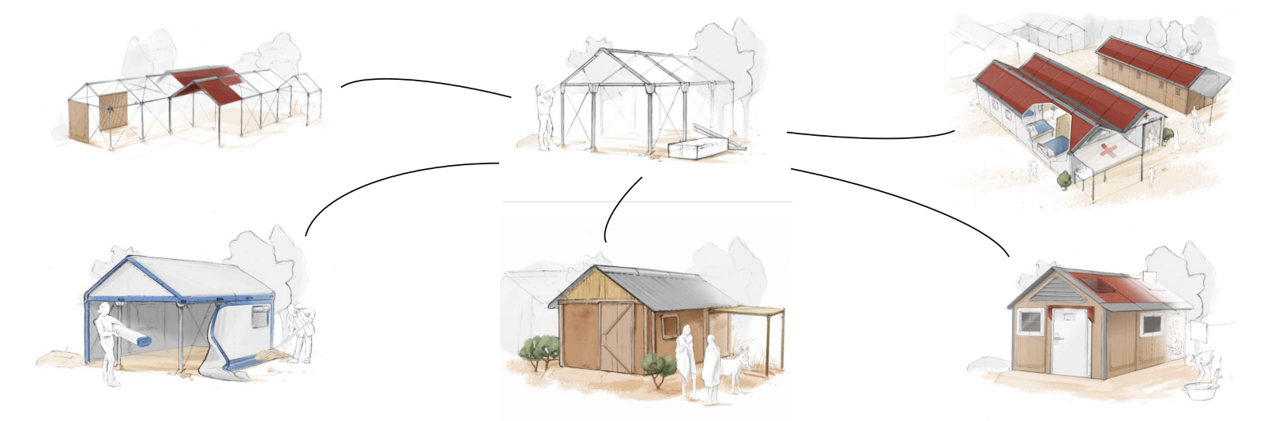
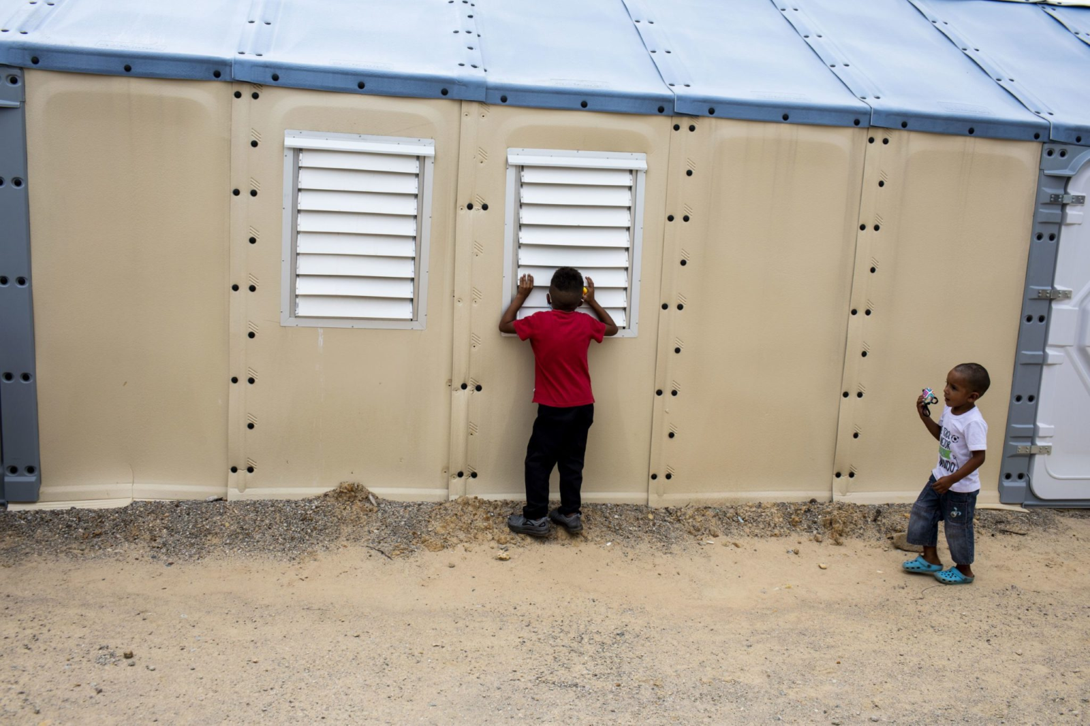
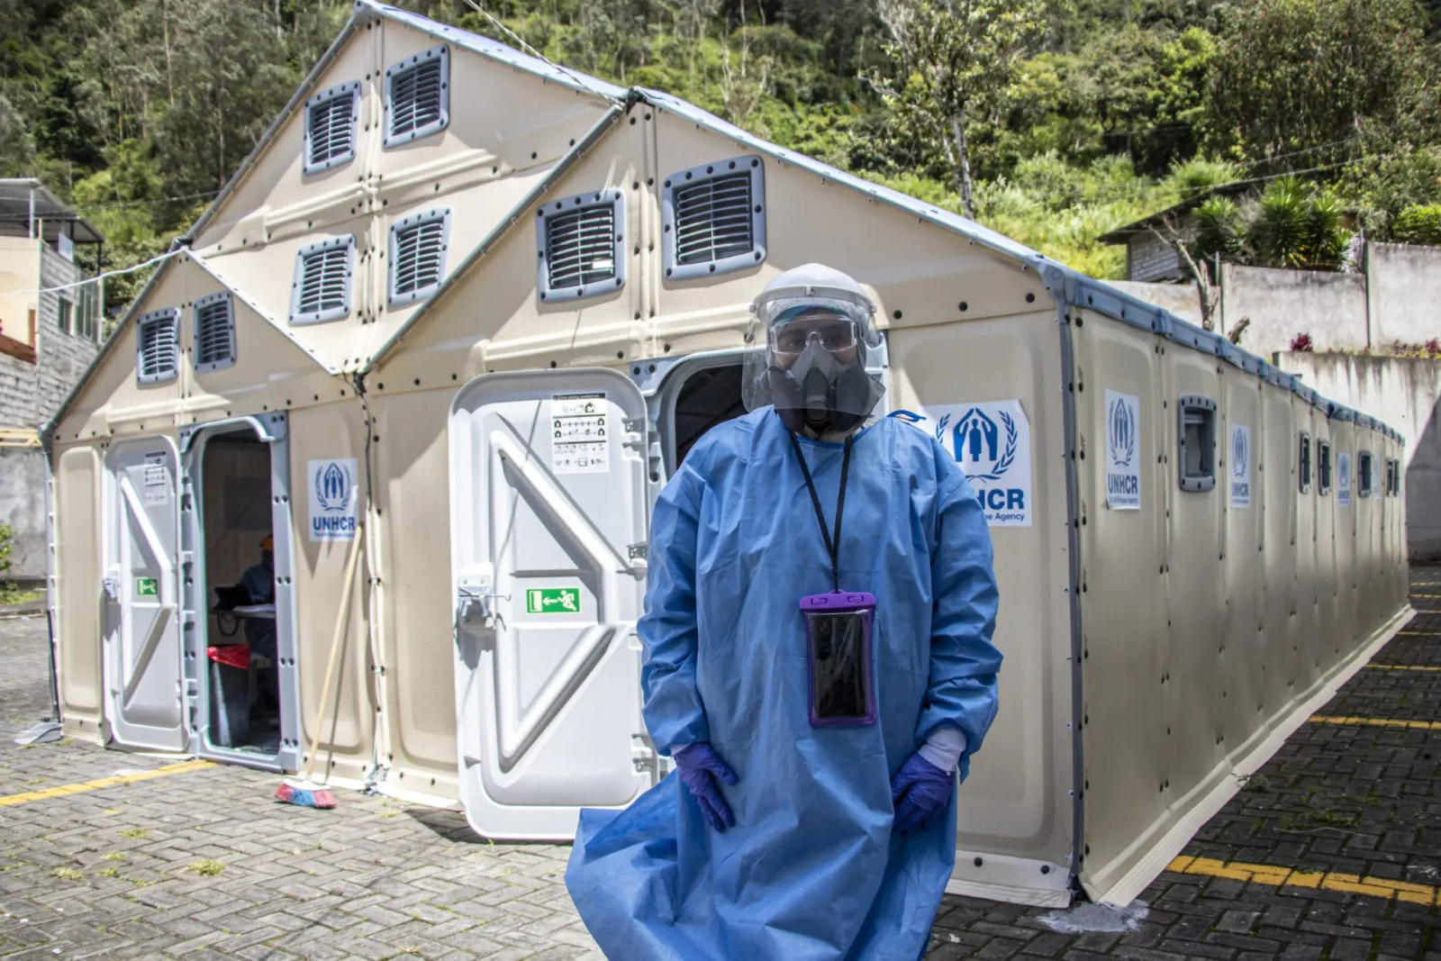
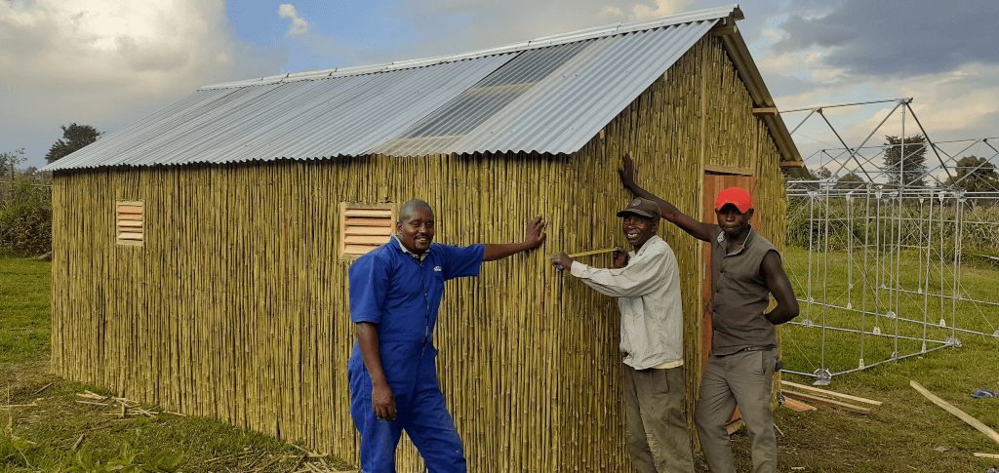
Modularity
Access to local resources and insulation
Notes:
Fast and easy assembly (4 hours, 4 people, no tools)
Optimized production (4 flat packed boxes, relatively low cost and weight)
Long term alternative (lasts 3 years, more secure and durable than tents)
Multipurpose expandability (steel structure can be combined to become bigger for schools and infirmaries)

Slide 12
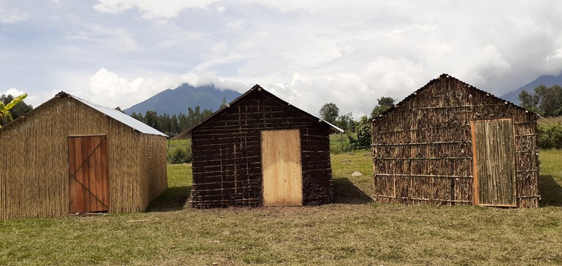
Cerini (2023)
If not?
Rwanda – straw mats on roof
Afghanistan – wood panels
India – mud and bamboo
Iraq – concrete slabs on floor

Slide 13
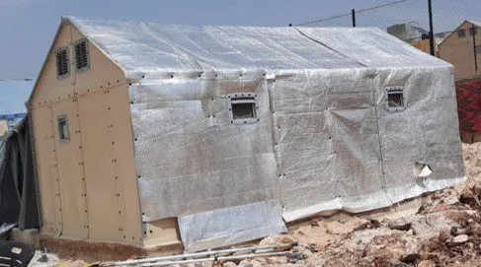
Snow (2013)
Aluminum fabric prone to fast corrosion
Shade net fastening threatens ventilation
Defeats intention of semi-opaque panels
Polyolefim R-value = 0.77 per inch (5x less than alternative insulative materials)
Ranges 5-40°C indoors
Revised Problem:
Poor Insulation with Shade Net and Panel Material
Notes:
Already has two design iterations with these improvements
Increased accessibility, non-flammability, local employment and material use, ventilation

Slide 14
Revised Evaluation
Daylight analysis with realistic window configurations
+
Heat/structural analysis with materials
Focus on light and thermal comfort modularity, especially for countries without immediate access to local materials that are better-suited for the weather
=
Visualize optimal window placements and insulative materials classified by climate zones
Djokovic (2022), Ayse (2019), Dong (2023), Eslam (2019)
Notes:
Natural light is important for conducting tasks safely and for physical health
Less dependence on solar panel can potentially reduce costs in its production and maintenance, can reserve it for cloudy days and night time
Avoid disuse and waste since it’s been reported that a lot of units are not being used and they reverted back to standard UNHCR tent, which is half the price and assembly effort, not as durable and long-term but lets more light in

Slide 15
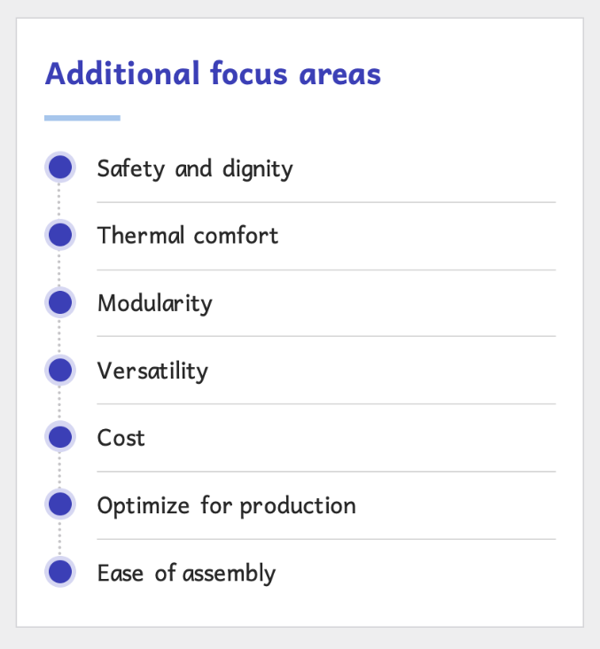
Importance
Less dependence on solar panel use, maintenance, and production
Avoid disuse, waste, and reverting back to tents
Ensure health, safety, and productivity of inhabitants
Streamline design process
Provide user-friendly information
Save costs for scalability
Provide better alternative in emergency situations
Increase adaptability for global use
Broad applicability
Annual report 2022
Notes:
Vertical and lower windows have more direct sunlight while higher windows are better for even distribution
Finding distance ‘sweet spot’ depends on all variables and room size
Number and size could be interchangeable to make up for the lack of the other
Factors affect one another and should be isolated even further for next study
Next steps include more in-depth structural analysis (max displacement, min thickness) for more informed optimization of all variables together
Also can separate panels and project windows onto them individually rather than array function for more control
Can even explore heat/temperature and shade mechanisms

Slide 16
Variables
Objective
Windows
Location weather
Representatives from grouped climate zones
Panel material
R-values and UV resistance
Misc. durability properties
Daylight
Indoor heat and insulation
Match performance of local materials
Structure
Mass (min. thickness <5mm)
Match existing weather performances (snow/rain load, wind resistance)
Dikmen & Ozkan (2016), Terne (2022)
Notes:
Natural light is important for conducting tasks safely and for physical health
Less dependence on solar panel can potentially reduce costs in its production and maintenance, can reserve it for cloudy days and night time
Avoid disuse and waste since it’s been reported that a lot of units are not being used and they reverted back to standard UNHCR tent, which is half the price and assembly effort, not as durable and long-term but lets more light in

Slide 17
Next Steps
Further literature review
Narrow down ideas and parameterize everything
Diversify material database and figure out key property navigation
Run structural analysis
Construct heat analysis script
Test windows with different climate zones
Incorporate machine learning
Brainstorm final design space and filtering
Notes:
Vertical and lower windows have more direct sunlight while higher windows are better for even distribution
Finding distance ‘sweet spot’ depends on all variables and room size
Number and size could be interchangeable to make up for the lack of the other
Factors affect one another and should be isolated even further for next study
Next steps include more in-depth structural analysis (max displacement, min thickness) for more informed optimization of all variables together
Also can separate panels and project windows onto them individually rather than array function for more control
Can even explore heat/temperature and shade mechanisms

Slide 18
References
Ayse Fidan Altun, & Muhsin Kılıç. (2019, March). Influence of Window Parameters on the Thermal Performance of Office Rooms in Different Climate Zones of Turkey. ResearchGate; International Journal of Renewable Energy Research. https://www.researchgate.net/publication/331959530_Influence_of_Window_Parameters_on_the_Thermal_Performance_of_Office_Rooms_in_Different_Climate_Zones_of_Turkey
Bealey, J. (2016, June 14). Winsulation Double Glazing. Winsulation. https://winsulation.com.au/importance-window-placement-home/uncategorized/#:~:text=Window%20placement%20for%20thermal%20control&text=Windows%20facing%20east%20and%20west,home's%20exposure%20to%20cool%20breezes
Better Shelter (2023, January 1). Annual review 2022 - Global Compact Communication on Progress. https://bettershelter.org/wp-content/uploads/2023/07/2022_Annual-review-FINAL-for-design-Better_Shelter-078-01-1.pdf
Cerini, M. (2023, August 31). Home in a box: Rethinking disaster relief, IKEA style. CNN. https://edition.cnn.com/style/better-shelter-home-disaster-ikea-dfi/index.html
Dikmen,N. & Ozkan, S. (2016). Unconventional Insulation Materials. InTech EBooks. https://doi.org/10.5772/63311
Djokovic, J. M., Nikolić, R. R., Bujnak, J., & Ulewicz, R. (2022, January 4). Selection of the Optimal Window Type and Orientation for the Two Cities in Serbia and One in Slovakia. ResearchGate; MDPI. https://www.researchgate.net/publication/357626850_Selection_of_the_Optimal_Window_Type_and_Orientation_for_the_Two_Cities_in_Serbia_and_One_in_Slovakia
Dong, Y., Kong, J., Mousavi, S., Behzad Rismanchi, & Yap, P.-S. (2023). Wall Insulation Materials in Different Climate Zones: A Review on Challenges and Opportunities of Available Alternatives. Thermo, 3(1), 38–65. https://doi.org/10.3390/thermo3010003
Eslam Elsamahy, & Mary nabil Felix. (2019, November). THE APPROPRIATE BUILDING MATERIALS FOR ENERGY SAVING IN DIFFERENT CLIMATE ZONES IN EGYPT. ResearchGate; Beirut Arab University. https://www.researchgate.net/publication/338528315_THE_APPROPRIATE_BUILDING_MATERIALS_FOR_ENERGY_SAVING_IN_DIFFERENT_CLIMATE_ZONES_IN_EGYPT
Fairs, M. (2017, April 27). IKEA refugee shelter to be redesigned following safety fears and design flaws. Dezeen; Dezeen. https://www.dezeen.com/2017/04/27/ikea-unhcr-refugee-better-shelter-redesign-safety-fears-flaws/
Johnson, N. (2015). Construction & Architecture News | Architecture & Design. Architecture & Design. https://www.architectureanddesign.com.au/news/ikea-produces-10-000-flat-pack-shelters-for-un-ref
Kumar, M. (2023, April 7). Illuminance Levels Indoors: Your Standard Lux Level Chart‍. Prana Air. https://www.pranaair.com/blog/illuminance-levels-indoors-the-standard-lux-levels/
Peters, A. (2021, February 10). These quick-build disaster shelters can later become permanent houses. Fast Company. https://www.fastcompany.com/90602483/these-quick-build-disaster-shelters-can-later-become-permanent-houses
Scott-Smith, T. (2017, December 14). A Slightly Better Shelter? Limn. https://limn.it/articles/a-slightly-better-shelter/
Snow, S. (2013, June 26). A New Ingeniously Designed Shelter For Refugees–Made By Ikea. Fast Company; Fast Company. https://www.fastcompany.com/2682416/a-new-ingeniously-designed-shelter-for-refugees-made-by-ikea
Szondy, D. (2013, July 1). Ikea’s turns its flat-pack philosophy to improving refugee shelters. New Atlas. https://newatlas.com/ikea-refugee-shelter/28105/
Terne, M. (2022, January 14). Relief Housing Unit (RHU) | BetterShelter. Bettershelter.org. https://bettershelter.org/our-shelters__trashed/relief-housing-unit-rhu/
Wainwright, O. (2017, January 27). Why Ikea’s flatpack refugee shelter won design of the year. The Guardian. https://www.theguardian.com/artanddesign/2017/jan/27/why-ikea-flatpack-refugee-shelter-won-design-of-the-year

